Slide 1
Bootstrap – 폼양식
쉽고 빠른 웹 프레임워크

Slide 2
Bootstrap 폼(Form)
부트스트랩 기본 설정
  부트스트랩 폼 구조
    <form> : 기본은 수직(vertical) 레이아웃
    <form class=“form-inline”> : 왼쪽 정렬과 inline-block controls
    <form class=“form-horizontal”> : label과 form group의 수평(horizontal) 레이아웃
  텍스트 관련 입력 양식에는 반드시 class=“form-control” 을 추가하고, 가로 사이즈는 자 동 반응형으로 동작된다.
    <input>
    <textarea>
    <select>
  Label과 form controls는 <div class=“form-group”>으로 묶어준다.

Slide 3
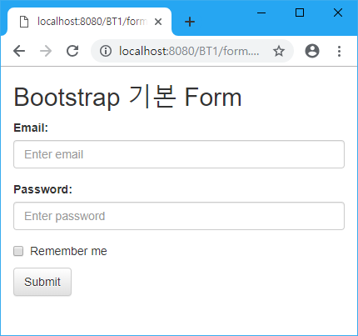
Bootstrap 폼(Form) – 기본 수직 폼
<div class="container">
<h2>Bootstrap 기본 Form</h2>
<form>
<div class="form-group">
<label for="email">Email:</label>
<input type="email" class="form-control" id="email" placeholder="Enter email" name="email">
</div>
<div class="form-group">
<label for="pwd">Password:</label>
<input type="password" class="form-control" id="pwd" placeholder="Enter password" name="pwd">
</div>
<div class="checkbox">
<label><input type="checkbox" name="remember"> Remember me</label>
</div>
<button type="submit" class="btn btn-default">Submit</button>
</form>
</div>

Slide 4
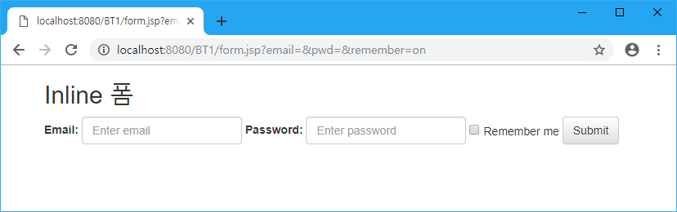
Bootstrap 폼(Form) - Inline 폼
sm 스크린 사이즈 이상에서는 inline 동작하고, 그 이하에서는 스택처럼 쌓인다.
<h2>Inline 폼</h2>
<form class="form-inline">
<div class="form-group">
<label for="email">Email:</label>
<input type="email" class="form-control" id="email" placeholder="Enter email" name="email">
</div>
<div class="form-group">
<label for="pwd">Password:</label>
<input type="password" class="form-control" id="pwd" placeholder="Enter password" name="pwd">
</div>
<div class="checkbox">
<label><input type="checkbox" name="remember"> Remember me</label>
</div>
<button type="submit" class="btn btn-default">Submit</button>
</form>

Slide 5
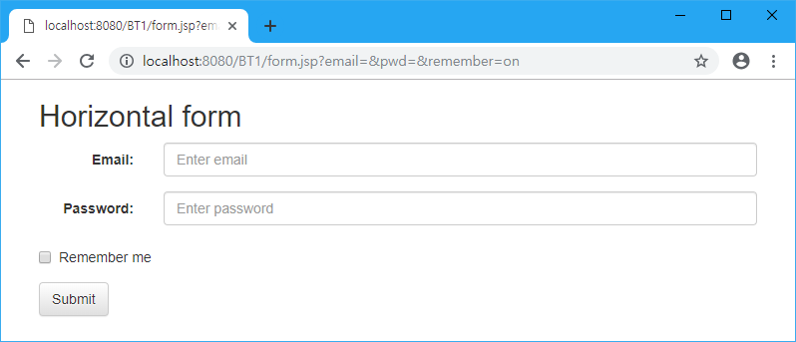
Bootstrap 폼(Form) - 수평 폼
sm 스크린 사이즈 이상에서는 수평으로 동작하고, 그 이하에서는 스택처럼 쌓인다.
<h2>Horizontal form</h2>
<form class="form-horizontal">
<div class="form-group">
<label class="control-label col-sm-2" for="email">Email:</label>
<div class="col-sm-10">
<input type="email" class="form-control" id="email" placeholder="Enter email" name="email">
</div>
</div>
<div class="form-group">
<label class="control-label col-sm-2" for="pwd">Password:</label>
<div class="col-sm-10">
<input type="password" class="form-control" id="pwd" placeholder="Enter password" name="pwd">
</div>
</div>
<div class="form-group">
<div class="col-sm-12">
<div class="checkbox">
<label><input type="checkbox" name="remember"> Remember me</label>
</div>
</div>
</div>
<div class="form-group">
<div class="col-sm-12">
<button type="submit" class="btn btn-default">Submit</button>
</div>
</div>
</form>

Slide 6
Bootstrap 폼 컨트롤(Form Controls)
부트스트랩 지원 폼 컨트롤
  input
  textarea
  checkbox
  radio
  select
부트스트랩은 모든 HTML5 input types을 지원
  text, password, datetime, datetime-local, date, month, time, week, number, email, url, search, tel, and color

Slide 7
Text & Password
<div class="form-group">
<label for="usr">Name:</label>
<input type="text" class="form-control" id="usr">
</div>
<div class="form-group">
<label for="pwd">Password:</label>
<input type="password" class="form-control" id="pwd">
</div>

Slide 8
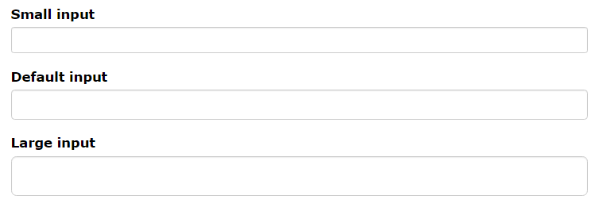

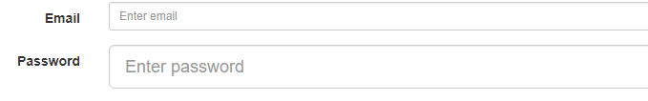
Input sizing
Input height size
<input type="text" class="form-control input-sm">
Input colum size
<div class="col-xs-2">
sm
lg

Slide 9
Textarea
<div class="form-group">
<label for="comment">Comment:</label>
<textarea class="form-control" rows="5" id="comment">
</textarea>
</div>

Slide 10
Checkbox
<div class="checkbox">
<label><input type="checkbox" value="">Option 1</label>
</div>
<div class="checkbox">
<label><input type="checkbox" value="">Option 2</label>
</div>
<div class="checkbox disabled">
<label><input type="checkbox" value="" disabled>Option 3</label>
</div>
체크박스를 같은 줄에 작성할 때 : class="checkbox-inline“

Slide 11
Radio
<div class="radio">
<label><input type="radio" name="optradio" checked>Option 1</label>
</div>
<div class="radio">
<label><input type="radio" name="optradio">Option 2</label>
</div>
<div class="radio disabled">
<label><input type="radio" name="optradio" disabled>Option 3</label>
</div>
Radio button을 같은 줄에 작성할 때 : class=“radio-inline“

Slide 12
Select list
<div class="form-group">
<label for="sel1">Select list:</label>
<select class="form-control" id="sel1" multiple>
<option>1</option>
<option>2</option>
<option>3</option>
<option>4</option>
</select>
</div>

