Slide 1
전명근의 JSP 구성순서 20142515
1.Memberform+memberpro->loginform->testlogin->main->logout
(회원가입후로그인후로그아웃)
2.Memberform+memberpro->loginform->testlogin->main->list
(회원가입후로그인후회원목록보기)
3.Memberform+memberpro->loginform->testlogin->main->updateform+updatepro
(회원가입후로그인후회원정보수정)
4.Memberform+memberpro->loginform->testlogin->main->deleteform+deletepro
(회원가입후로그인후회원탈퇴)

Slide 2
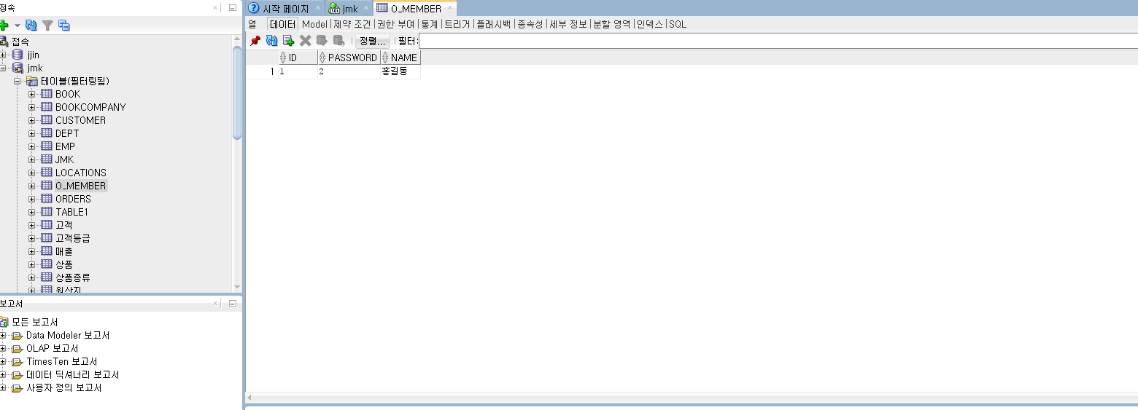
db

Slide 3
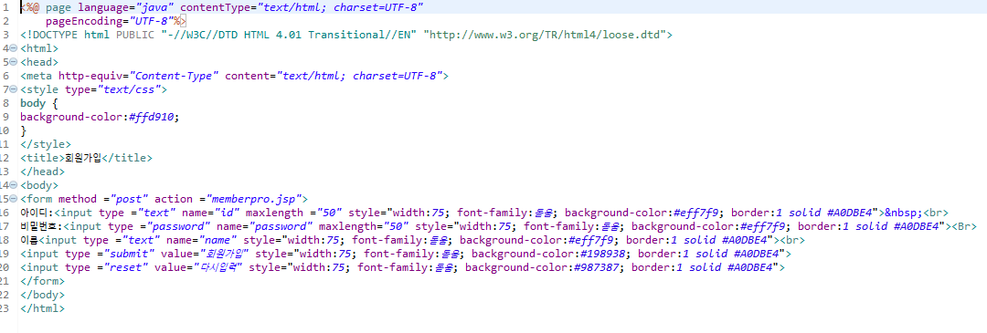
memberform

Slide 4
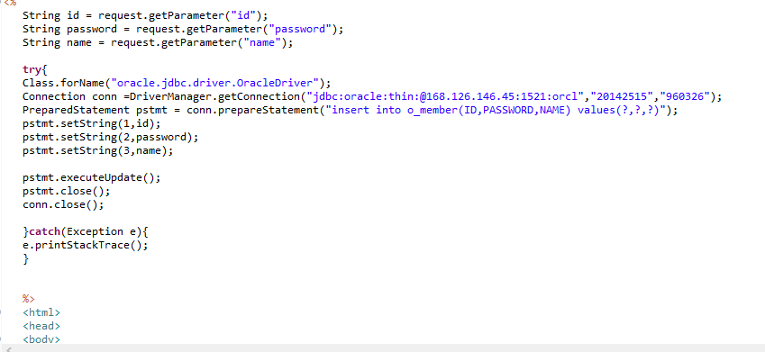
memberpro

Slide 5
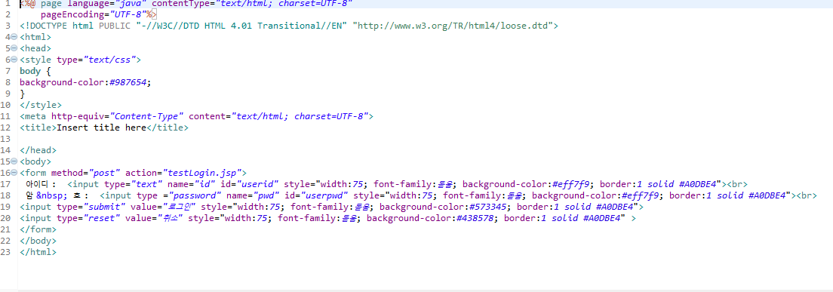
loginform

Slide 6
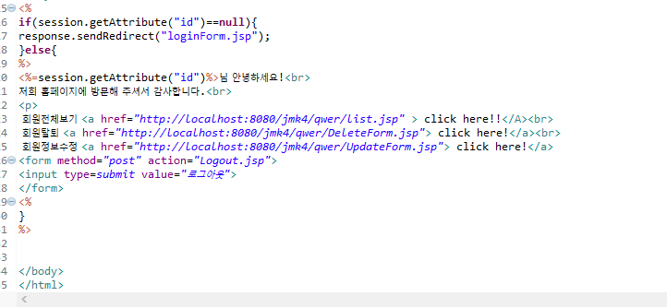
main

Slide 7
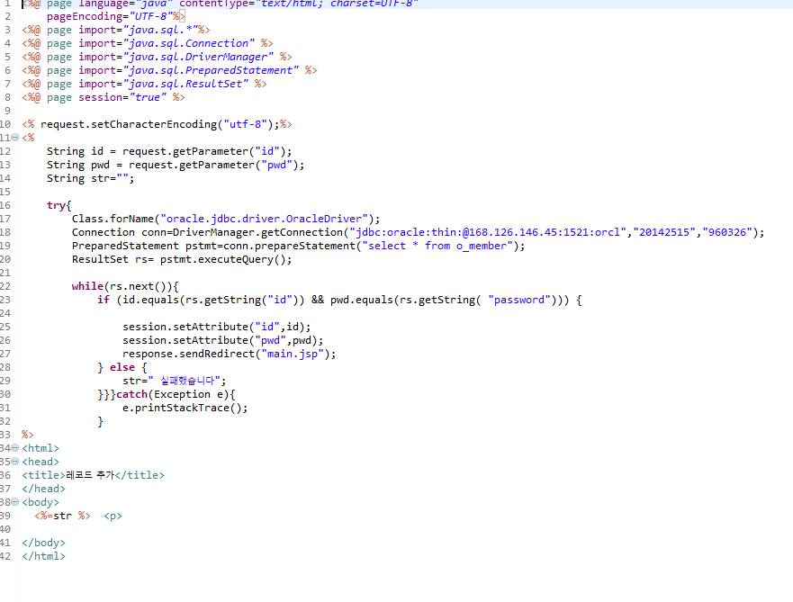
testlogin

Slide 8
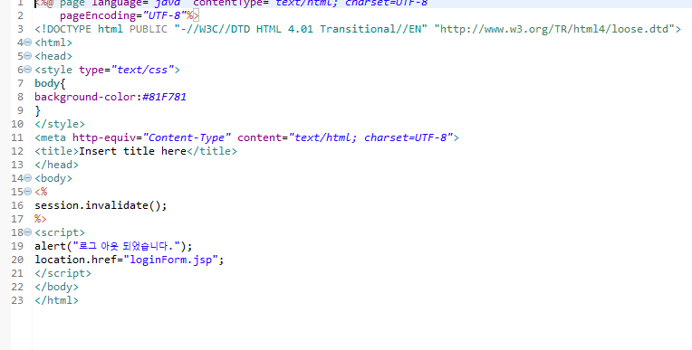
logout

Slide 9
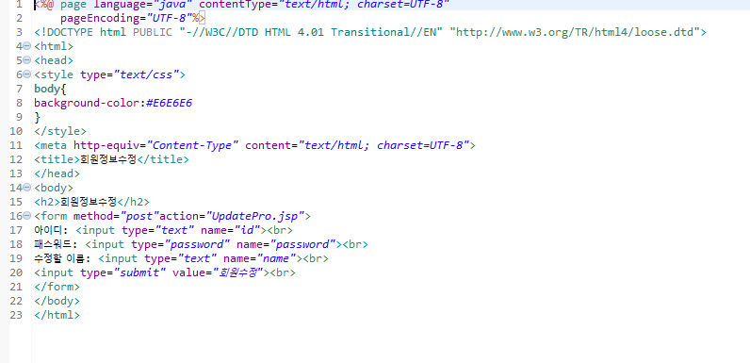
updateform

Slide 10
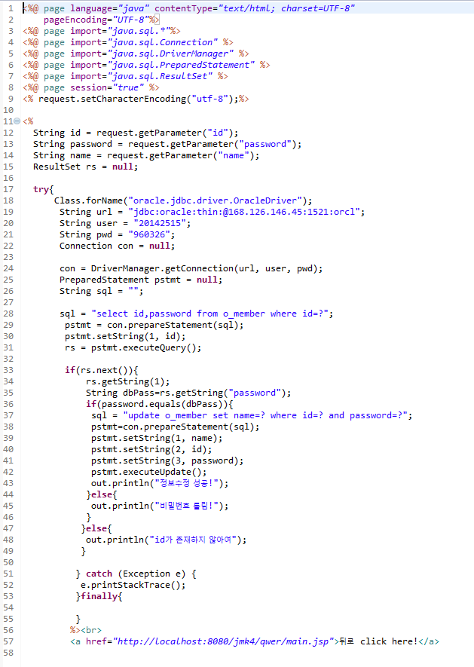
updatepro

Slide 11
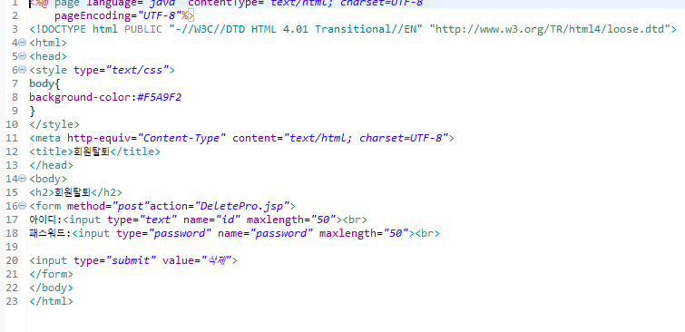
deleteform

Slide 12
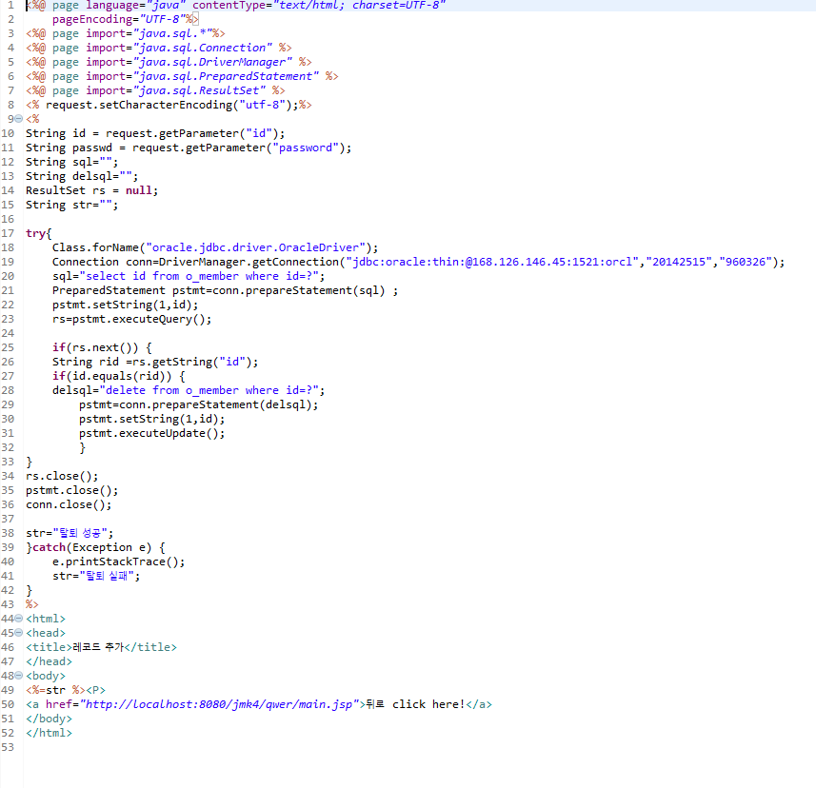
deletepro

