Slide 1
JSP
20152494 송상민

Slide 2
<회원가입,로그인,메인화면,회원탈퇴,정보수정 전체로직>
<회원탈퇴>
Delete.jsp
Deletepro.jsp
<회원가입>
<로그인>
<메인화면>
MemberForm.jsp
loginForm.jsp
main.jsp
MemberPro.jsp
testLogin.jsp
<정보수정>
update.jsp
list.jsp
logout.jsp
updatepro.jsp

Slide 3
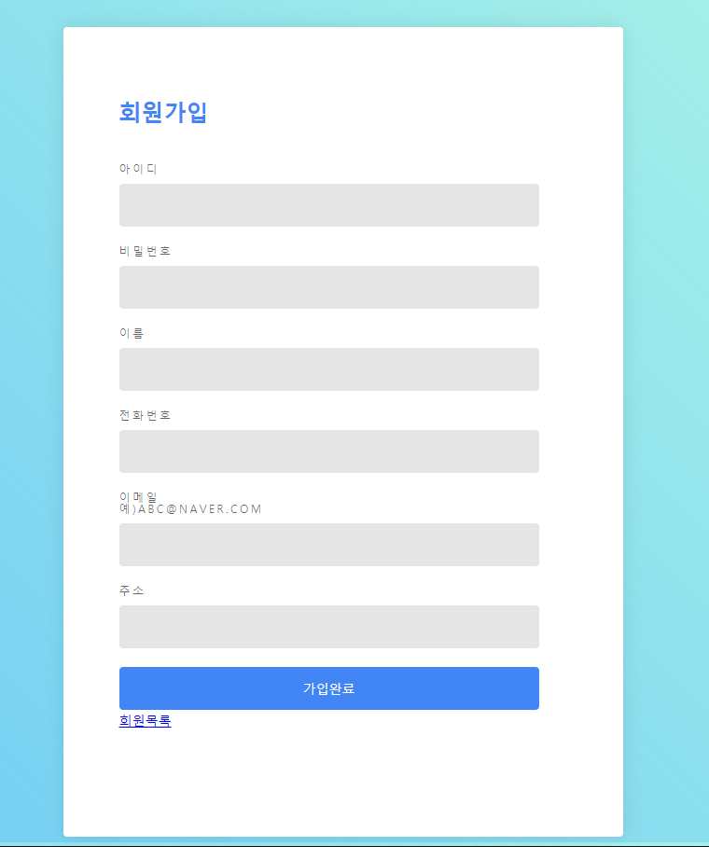
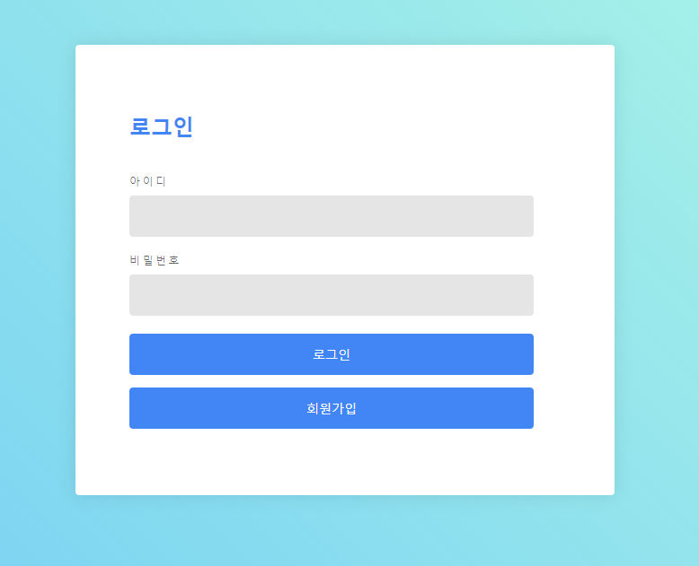
<MemberForm.jsp>
<loginForm.jsp>

Slide 4
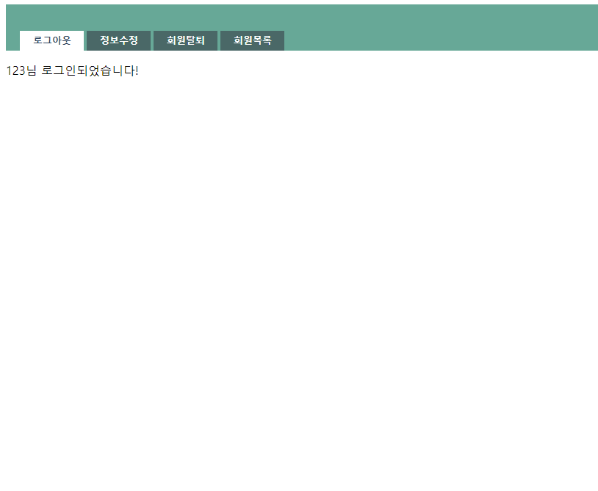
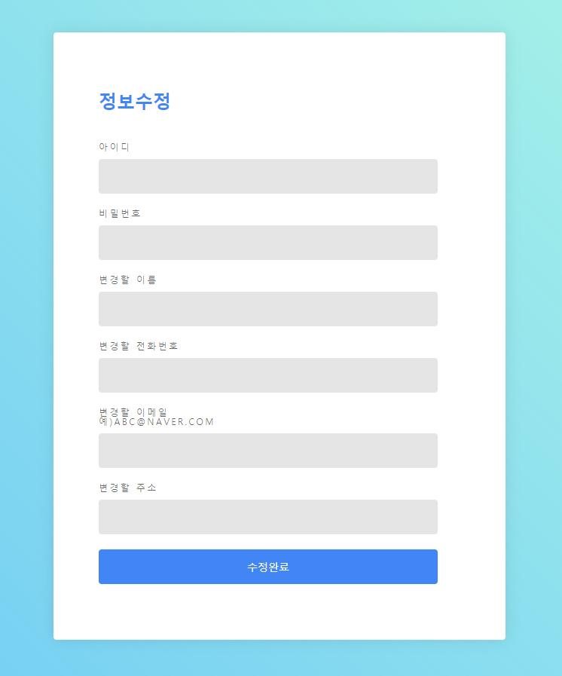
<main.jsp>
<update.jsp>

Slide 5
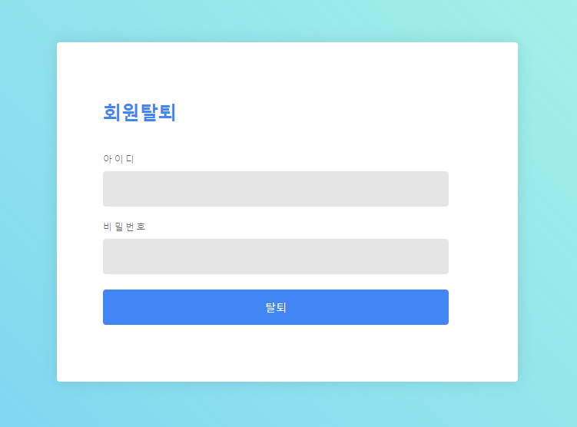
<Delete.jsp>

